Slide 1
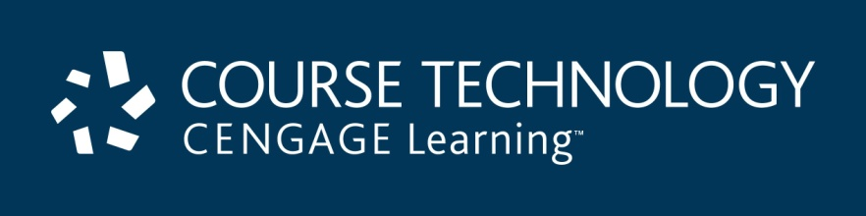
Ethics in Information Technology, Third Edition
Chapter 4
Privacy

Slide 2
Objectives
As you read this chapter, consider the following questions:
  What is the right of privacy, and what is the basis for protecting personal privacy under the law?
  What are some of the laws that provide protection for the privacy of personal data, and what are some of the associated ethical issues?
  What is identity theft, and what techniques do identity thieves use?
Ethics in Information Technology, Third Edition

Slide 3
Objectives (cont’d.)
  What are the various strategies for consumer profiling, and what are the associated ethical issues?
  What must organizations do to treat consumer data responsibly?
  Why and how are employers increasingly using workplace monitoring?
  What are the capabilities of advanced surveillance technologies, and what ethical issues do they raise?
Ethics in Information Technology, Third Edition

Slide 4
Privacy Protection and the Law
Systems collect and store key data from every interaction with customers to make better decisions
Many object to data collection policies of government and business
Privacy
  Key concern of Internet users
  Top reason why nonusers still avoid the Internet
Reasonable limits must be set
Historical perspective on the right to privacy
  Fourth Amendment reasonable expectation of privacy
Ethics in Information Technology, Third Edition

Slide 5
Information Privacy
Definition
  “The right to be left alone—the most comprehensive of rights, and the right most valued by a free people”
Combination of:
  Communications privacy
    Ability to communicate with others without being monitored by other persons or organizations
  Data privacy
    Ability to limit access to one’s personal data by other individuals and organizations in order to exercise a substantial degree of control over that data and its use
Ethics in Information Technology, Third Edition

Slide 6
Privacy Laws, Applications, and Court Rulings
Legislative acts passed over the past 40 years
  Most address invasion of privacy by the government
  No protection of data privacy abuses by corporations
  No single, overarching national data privacy policy
Financial data
  Fair Credit Reporting Act of 1970
    Regulates operations of credit-reporting bureaus
  Gramm-Leach-Bliley Act (GLBA)
    Bank deregulation that allowed banks to merge
    Three key rules affecting personal privacy
Ethics in Information Technology, Third Edition

Slide 7
Privacy Laws, Applications, and Court Rulings (cont’d.)
Opt-out policy
  Assumes that consumers approve of companies collecting and storing their personal information
  Requires consumers to actively opt out
  Favored by data collectors
Opt-in policy
  Must obtain specific permission from consumers before collecting any data
  Favored by consumers
Ethics in Information Technology, Third Edition

Slide 8
Privacy Laws, Applications, and Court Rulings (cont’d.)
Health Information
  Health Insurance Portability and Accountability Act of 1996 (HIPAA)
    Improves the portability and continuity of health insurance coverage
    Reduces fraud, waste, and abuse
    Simplifies the administration of health insurance
Children’s Personal Data
  Children’s Online Privacy Protection Act (1998)
    Must notify parents or guardians about its data-collection practices and receive parental consent
Ethics in Information Technology, Third Edition

Slide 9
Privacy Laws, Applications, and Court Rulings (cont’d.)
Electronic Surveillance
  Communications Act of 1934
    Established the Federal Communications Commission
    Regulates all non-federal-government use of radio and television
  Title III of the Omnibus Crime Control and Safe Streets Act (Wiretap Act)
    Regulates the interception of wire (telephone) and oral communications
  Foreign Intelligence Surveillance Act (FISA) of 1978
    Monitors communications between foreign powers
Ethics in Information Technology, Third Edition

Slide 10
Privacy Laws, Applications, and Court Rulings (cont’d.)
Foreign Intelligence Surveillance Amendments Act
  Implemented legal protections for electronic communications service providers
Electronic Communications Privacy Act of 1986 (ECPA)
  Protects communications in transfer from sender to receiver
  Protects communications held in electronic storage
  Prohibits recording dialing, routing, addressing, and signaling information without a search warrant
Ethics in Information Technology, Third Edition

Slide 11
Privacy Laws, Applications, and Court Rulings (cont’d.)
Communications Assistance for Law Enforcement Act (CALEA) 1994
  Amended both the Wiretap Act and ECPA
  Required the telecommunications industry to build tools into its products so federal investigators could:
    Eavesdrop and intercept electronic communications
  Covered emerging technologies, such as:
    Wireless modems
    Radio-based electronic mail
    Cellular data networks
Ethics in Information Technology, Third Edition

Slide 12
Privacy Laws, Applications, and Court Rulings (cont’d.)
USA PATRIOT Act (Uniting and Strengthening America by Providing Appropriate Tools Required to Intercept and Obstruct Terrorism) 2001
  Increased ability of law enforcement agencies to search telephone, e-mail, medical, financial, and other records
  Eased restrictions on foreign intelligence gathering in the United States
  Relaxed requirements for National Security Letters (NSLs)
  “Sunset” provisions designated by Congress
Ethics in Information Technology, Third Edition

Slide 13
Privacy Laws, Applications, and Court Rulings (cont’d.)
Export of personal data
  Organisation for Economic Co-operation and Development Fair Information Practices (1980)
    Fair Information Practices
      Set of eight principles
      Model of ethical treatment of consumer data
  European Union Data Protection Directive
    Requires implementing set of privacy directives on the fair and appropriate use of information
      Set of seven principles for data privacy
Ethics in Information Technology, Third Edition

Slide 14
Privacy Laws, Applications, and Court Rulings (cont’d.)
BBBOnLine and TRUSTe
  Independent initiatives that favor an industry-regulated approach to data privacy
  Provide BBBOnLine reliability seal or a TRUSTe data privacy seal
  Seals
    Increase consumer confidence in site
    Help users make more informed decisions about whether to release personal information
Ethics in Information Technology, Third Edition

Slide 15
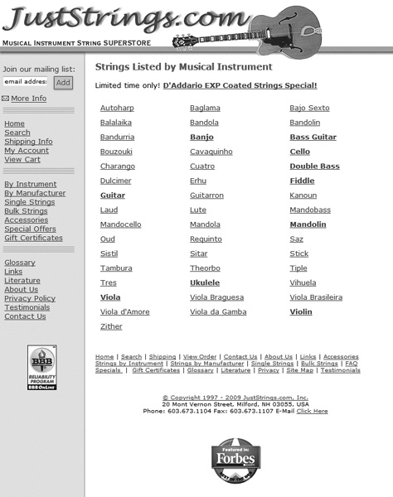
Ethics in Information Technology, Third Edition

Slide 16
Privacy Laws, Applications, and Court Rulings (cont’d.)
Access to Government Records
  Freedom of Information Act (FOIA) (1966 amended 1974)
    Grants citizens the right to access certain information and records of the federal government upon request
    Exemptions bar disclosure of information that could:
      Compromise national security
      Interfere with active law enforcement investigation
  The Privacy Act of 1974
    Prohibits government agencies from concealing the existence of personal data record-keeping system
Ethics in Information Technology, Third Edition

Slide 17
Key Privacy and Anonymity Issues
Identity theft
Consumer profiling
Treating customer data responsibly
Workplace monitoring
Advanced surveillance technology
Ethics in Information Technology, Third Edition

Slide 18
Identity Theft
Theft of key pieces of personal information to impersonate a person
Information includes:
  Name
  Address
  Date of birth
  Social Security number
  Passport number
  Driver’s license number
  Mother’s maiden name
Ethics in Information Technology, Third Edition

Slide 19
Identity Theft (cont’d.)
Fastest growing form of fraud in the United States
Consumers and organizations are becoming more vigilant and proactive in fighting identity theft
Four approaches used by identity thieves
  Create a data breach
  Purchase personal data from criminals
  Use phishing to entice users to give up data
  Install spyware to capture keystrokes of victims
Ethics in Information Technology, Third Edition

Slide 20
Identity Theft (cont’d.)
Data breaches of large databases
  To gain personal identity information
  May be caused by:
    Hackers
    Failure to follow proper security procedures
Purchase of personal data
  Black market for:
    Credit card numbers in bulk—$.40 each
    Logon name and PIN for bank account—$10
    Identity information—including DOB, address, SSN, and telephone number—$15
Ethics in Information Technology, Third Edition

Slide 21
Identity Theft (cont’d.)
Phishing
  Stealing personal identity data by tricking users into entering information on a counterfeit Web site
Spyware
  Keystroke-logging software
  Enables the capture of:
    Account usernames
    Passwords
    Credit card numbers
    Other sensitive information
  Operates even if infected computer is not online
Ethics in Information Technology, Third Edition

Slide 22
Identity Theft (cont’d.)
Identity Theft and Assumption Deterrence Act of 1998 was passed to fight fraud
Identity Theft Monitoring Services
  Monitor the three major credit reporting agencies (TransUnion, Equifax, and Experian)
  Monitor additional databases (financial institutions, utilities, and DMV)
Ethics in Information Technology, Third Edition

Slide 23
Consumer Profiling
Companies openly collect personal information about Internet users
Cookies
  Text files that a Web site can download to visitors’ hard drives so that it can identify visitors later
Tracking software analyzes browsing habits
Similar controversial methods are used outside the Web environment
Ethics in Information Technology, Third Edition

Slide 24
Consumer Profiling (cont’d.)
Aggregating consumer data
  Databases contain a huge amount of consumer behavioral data
  Affiliated Web sites are served by a single advertising network
Collecting data from Web site visits
  Customized service for each consumer
  Types of data collected
    GET data
    POST data
    Click-stream data
Ethics in Information Technology, Third Edition

Slide 25
Consumer Profiling (cont’d.)
Four ways to limit or stop the deposit of cookies on hard drives
  Set the browser to limit or stop cookies
  Manually delete them from the hard drive
  Download and install a cookie-management program
  Use anonymous browsing programs that don’t accept cookies
Ethics in Information Technology, Third Edition

Slide 26
Consumer Profiling (cont’d.)
Personalization software
  Used by marketers to optimize the number, frequency, and mixture of their ad placements
    Rules-based
    Collaborative filtering
    Demographic filtering
    Contextual commerce
Consumer data privacy
  Platform for Privacy Preferences (P3P)
    Shields users from sites that don’t provide the level of privacy protection desired
Ethics in Information Technology, Third Edition

Slide 27
Treating Consumer Data Responsibly
Strong measures are required to avoid customer relationship problems
Companies should adopt:
  Fair Information Practices
  1980 OECD privacy guidelines
Chief privacy officer (CPO)
  Executive to oversee data privacy policies and initiatives
Ethics in Information Technology, Third Edition

Slide 28
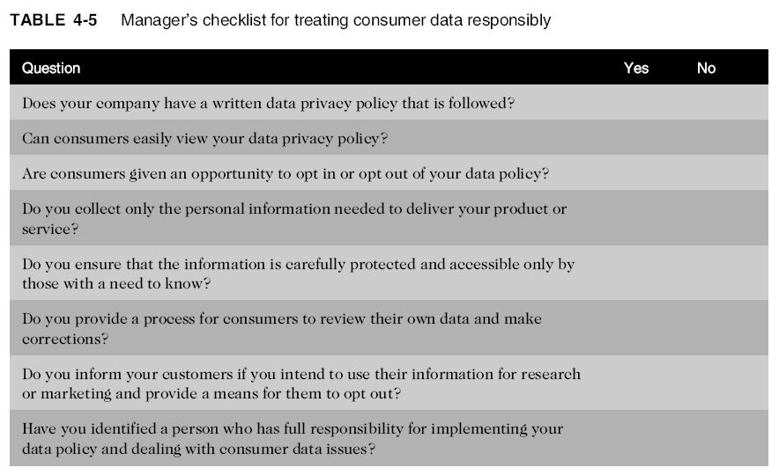
Treating Consumer Data Responsibly (cont’d.)
Ethics in Information Technology, Third Edition

Slide 29
Workplace Monitoring
Employers monitor workers
  Ensure that corporate IT usage policy is followed
Fourth Amendment cannot be used to limit how a private employer treats its employees
  Public-sector employees have far greater privacy rights than in the private industry
Privacy advocates want federal legislation
  To keep employers from infringing upon privacy rights of employees
Ethics in Information Technology, Third Edition

Slide 30
Advanced Surveillance Technology
Camera surveillance
  U.S. cities plan to expand surveillance systems
  “Smart surveillance system”
Facial recognition software
  Identifies criminal suspects and other undesirable characters
  Yields mixed results
Global positioning system (GPS) chips
  Placed in many devices
  Precisely locate users
Ethics in Information Technology, Third Edition

Slide 31
Summary
Laws, technical solutions, and privacy policies are required to balance needs of business against rights of consumers
A number of laws have been enacted over the past 40 years that affect a person’s privacy
Identity theft is fastest-growing form of fraud
Web sites collect personal data about visitors
Consumer data privacy has become a major marketing issue
Ethics in Information Technology, Third Edition

Slide 32
Summary (cont’d.)
Code of Fair Information Practices and 1980 OECD privacy guidelines
Advances in information technology
  Surveillance cameras
  Facial recognition software
  GPS systems
Ethics in Information Technology, Third Edition

